Slide 1
Vaikų priežiūra- pokyčiams atspariausia
lyčių nelygybės sritis
Dr. Jolanta Reingardė
Europos lyčių lygybės institutas (EIGE)
LR Seimas, Vilnius, rugsėjis 2018

Slide 2
EU Gender Equality Index
Room for improvement
56.8

Slide 3
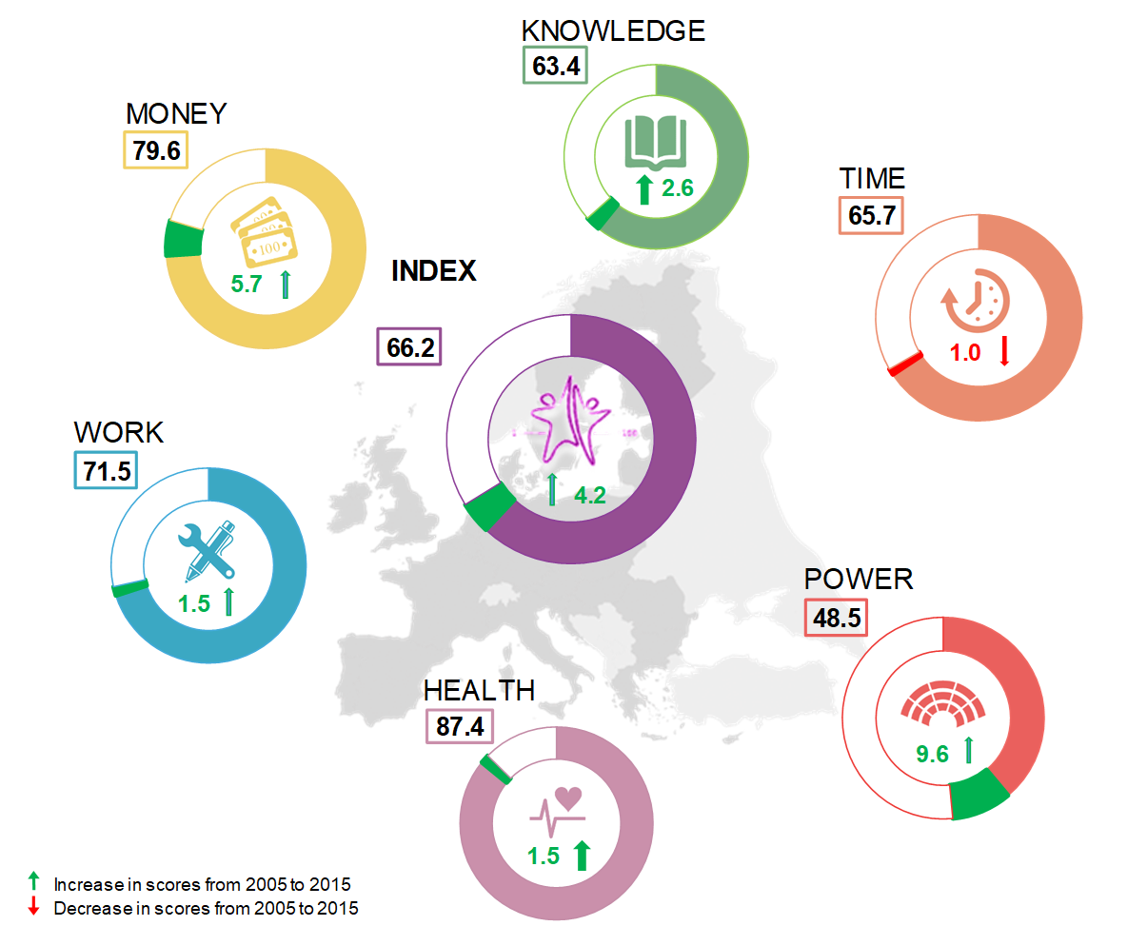
EU Gender Equality Index

Slide 4
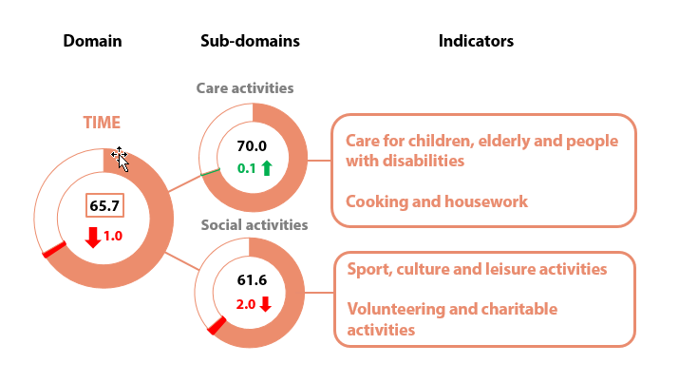
Domain of time (EU level)
Increase in scores from 2005 to 2015
Decrease in scores from 2005 to 2015

Slide 5
Scores of the domain of time

Slide 6

People engaged in caring and housework every day for at least 1 hour or more
Care for children, elderly and people with disabilities

Slide 7
People doing cooking and housework at least 1h/day by family type (LT)
71 %
53 %
97 %
23 %
84 %
28 %
Single
Couple with children
Couple without children

Slide 8
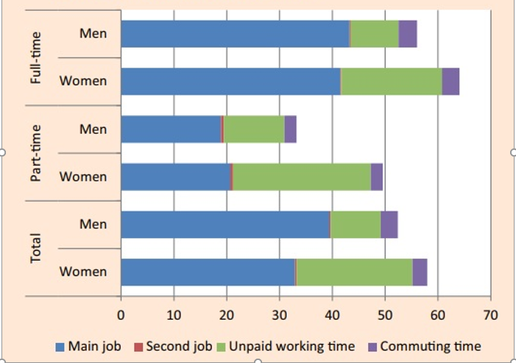
Paid and unpaid working hours/per week
by gender, EU, 2015
Source: Eurofound

Slide 9
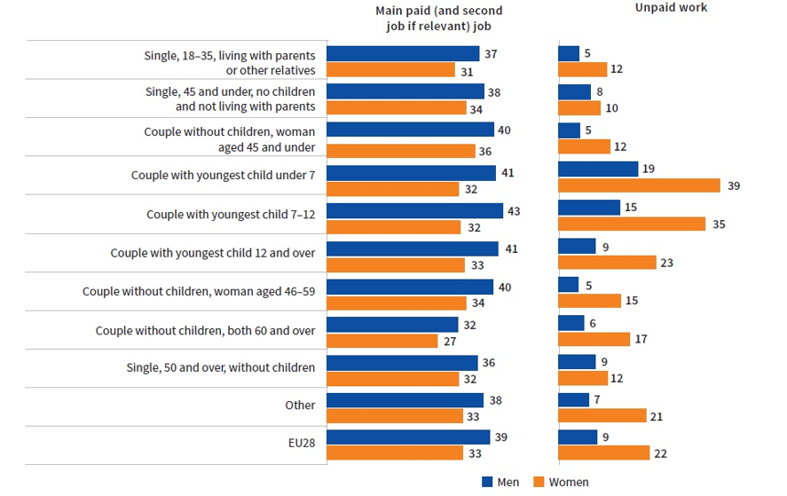
Unpaid and paid working time/per week by family composition, EU, 2015
Source: Eurofound

Slide 10
Part-time employment due to caring (looking after children or incapacitated adults), 2017
Source: Eurostat

Slide 11
Inactivity due to caring (looking after children or incapacitated adults), 2017
Source: Eurostat

Slide 12
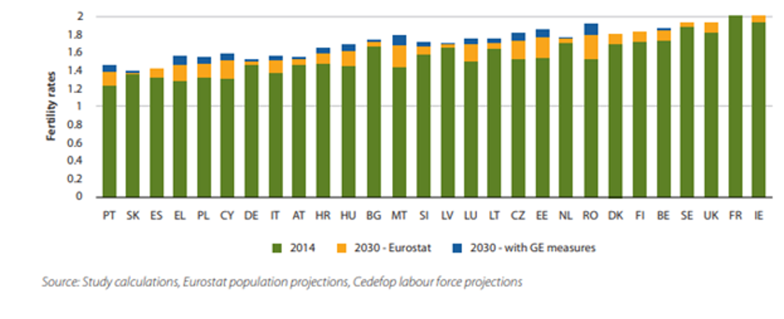
More equal distribution of caring leading to higher fertility rates: rapid progress scenario
Source: EIGE (2017) Economic benefits of gender equality in the European Union, EIGE

Slide 13
Explore the Gender Equality Index: http://eige.europa.eu/gender-statistics/gender-equality-index

